Slide 1
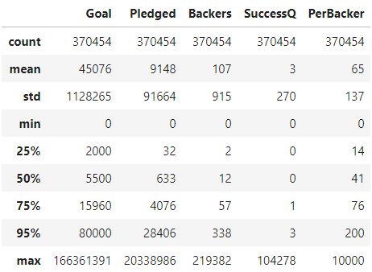
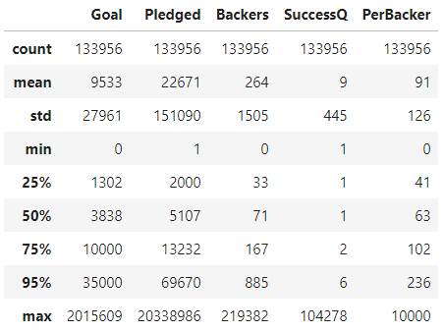
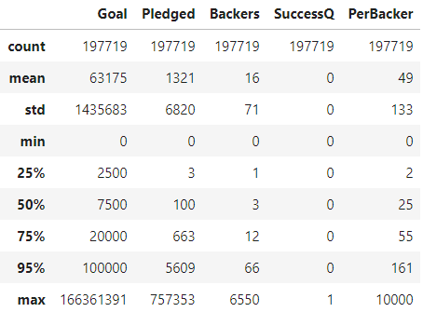
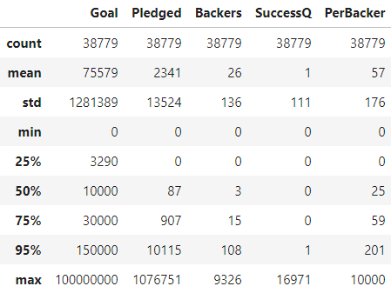
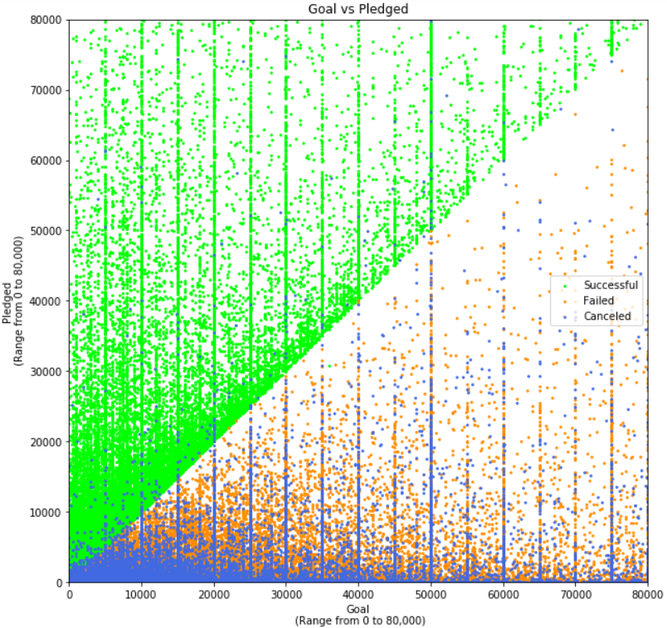
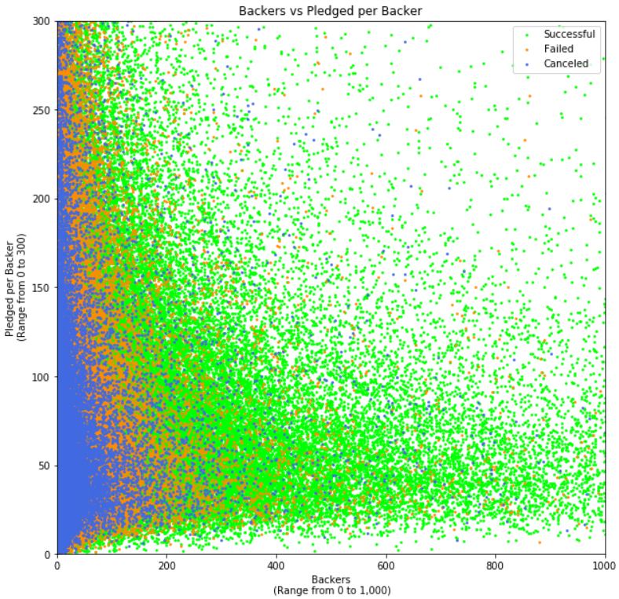
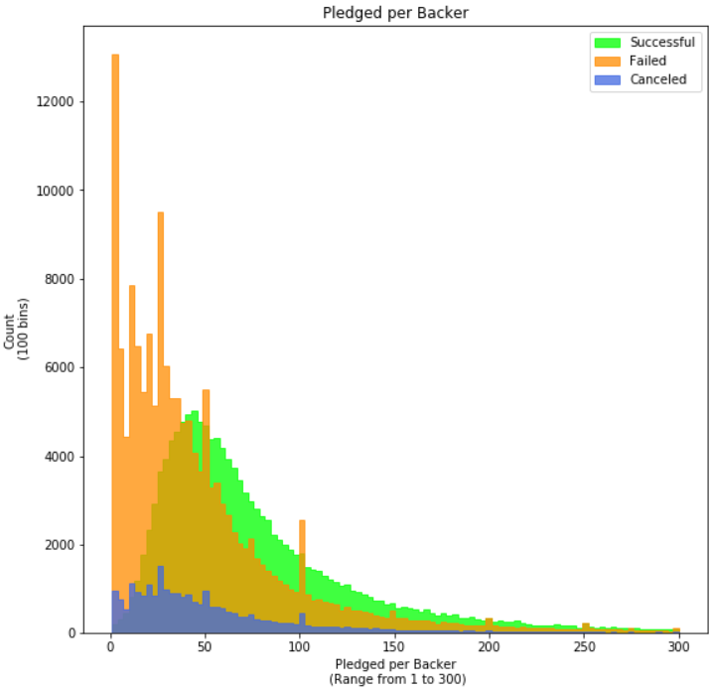
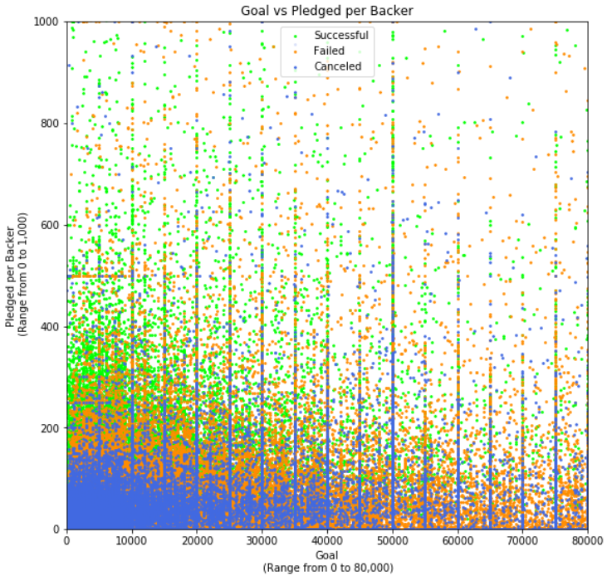
Working Set
Successful Projects
Failed Projects
Canceled Projects
The diagonal is not surprising as this is per definition. Interesting is that we can see that the majority of successful projects has low funding goals (compare stats) and some of those did incredibly well. Also noteworthy are the «human lines» at the 5k axes and the oddball nature of the canceled projects, which warrants further study.
What these graphs beautifully illustrate is that the successful projects didn’t necessarily garner huge amounts per backer. On the left graph we can see that there is a thickened band between around 20 and 100 dollars per backer. What really separates the successful projects from the others is that those for the most part did not manage to gather more than 200 backers.
This becomes very apparent when you check the graph. The backer mean is 10 to 15 times as high. The graph on the right illustrates this well too. The range had to be adjusted to not include $0 pledges, otherwise we would not have been able to make out any structure at all.
This graph is very interesting because you can almost not make out any successful projects. What you can see however are vertical and horizontal «human lines.» Fascinatingly, the horizontal lines are almost exclusively failed or canceled projects.
Notice there is almost a straight blue line at the 50k mark all the way up to $500 per backer.

